Slide 1
Blog dataset

Slide 2
What is in a blog?
blog, in full Web log or Weblog, online journal where an individual, group, or corporation presents a record of activities, thoughts, or beliefs. Some blogs operate mainly as news filters, collecting various online sources and adding short comments and Internet links.

Slide 3
Personal blog
The personal blog, ongoing diary or commentary by an individual ,is the traditional,most common blog

Slide 4
Features
The system we have developed allows user to create their own blog
They can publish their own opinions
In this system there are admins who takes care of the blog
The post may verified by the admins

Slide 5

People can like command and share the post
Compatible with pc , tab and mobile devices

Slide 6
Tools and languages
tools
Notepad ++
Xampp
languages
Sql
Php
Html
css
Java script

Slide 7
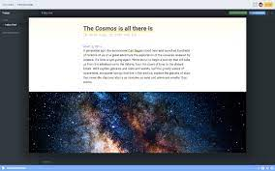
blog

Slide 8
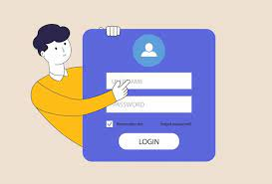
user login

Slide 9
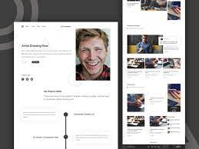
User view

Slide 10
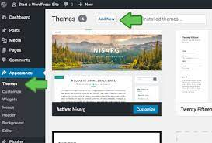
Creating blog

Slide 11
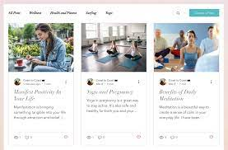
New blog added

Slide 12
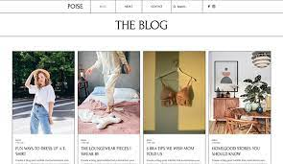
Blog image view

Slide 13
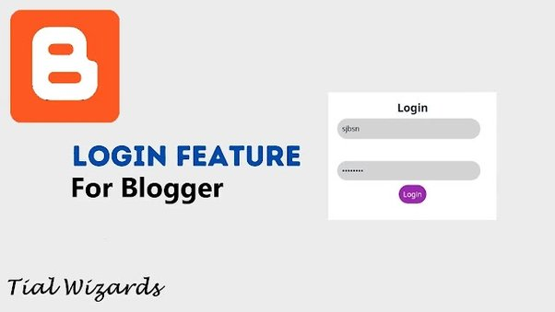
Admin login

Slide 14
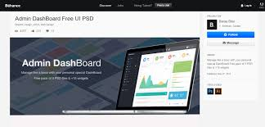
Admin dashboard

Slide 15
Advantages of blog
Freedom of speech
Share knowledge with other people
Make friends online
Can be used as a diary

Slide 16
thankyou

